Slide 1
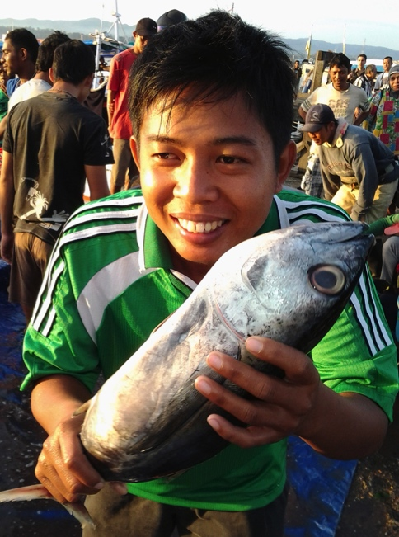
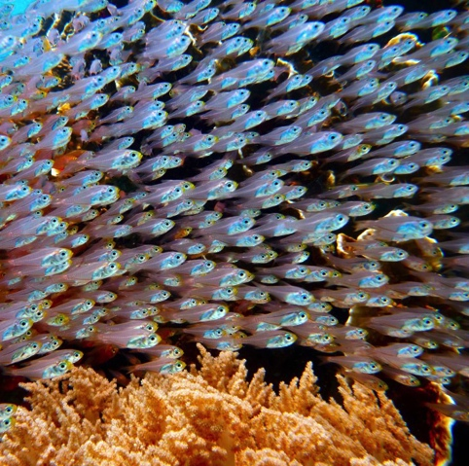
The future we want: our vision
Well-governed fisheries sector
Abundant fisheries resources
Healthy environment and habitats
Increased jobs, profits, and improved economy
Improved human health and prosperity
A legacy for you, your children, and future generations
Notes:
The vision.
These are examples of Key words and phrases that can be used to develop a vision statement. Based on these key words a vision statement could be:
“A well-governed fishery sector that promotes a healthy ecosystem and sustainable use of the marine resources for the benefit of the key stakeholders.

Slide 2
EA promotes sustainable development
GOOD GOVERNANCE
ECOLOGICAL WELL-BEING
HUMAN WELL-BEING
FOR FUTURE GENERATIONS
Notes:
Sustainable development can be thought of as a process that strives to balance human well-being (e.g. employment, profit and sustainable livelihoods) with ecological well-being (e.g. healthy fish resources and healthy environment) so that development achieved in one generation does impact development for future generations – our sons and daughters.

Slide 3
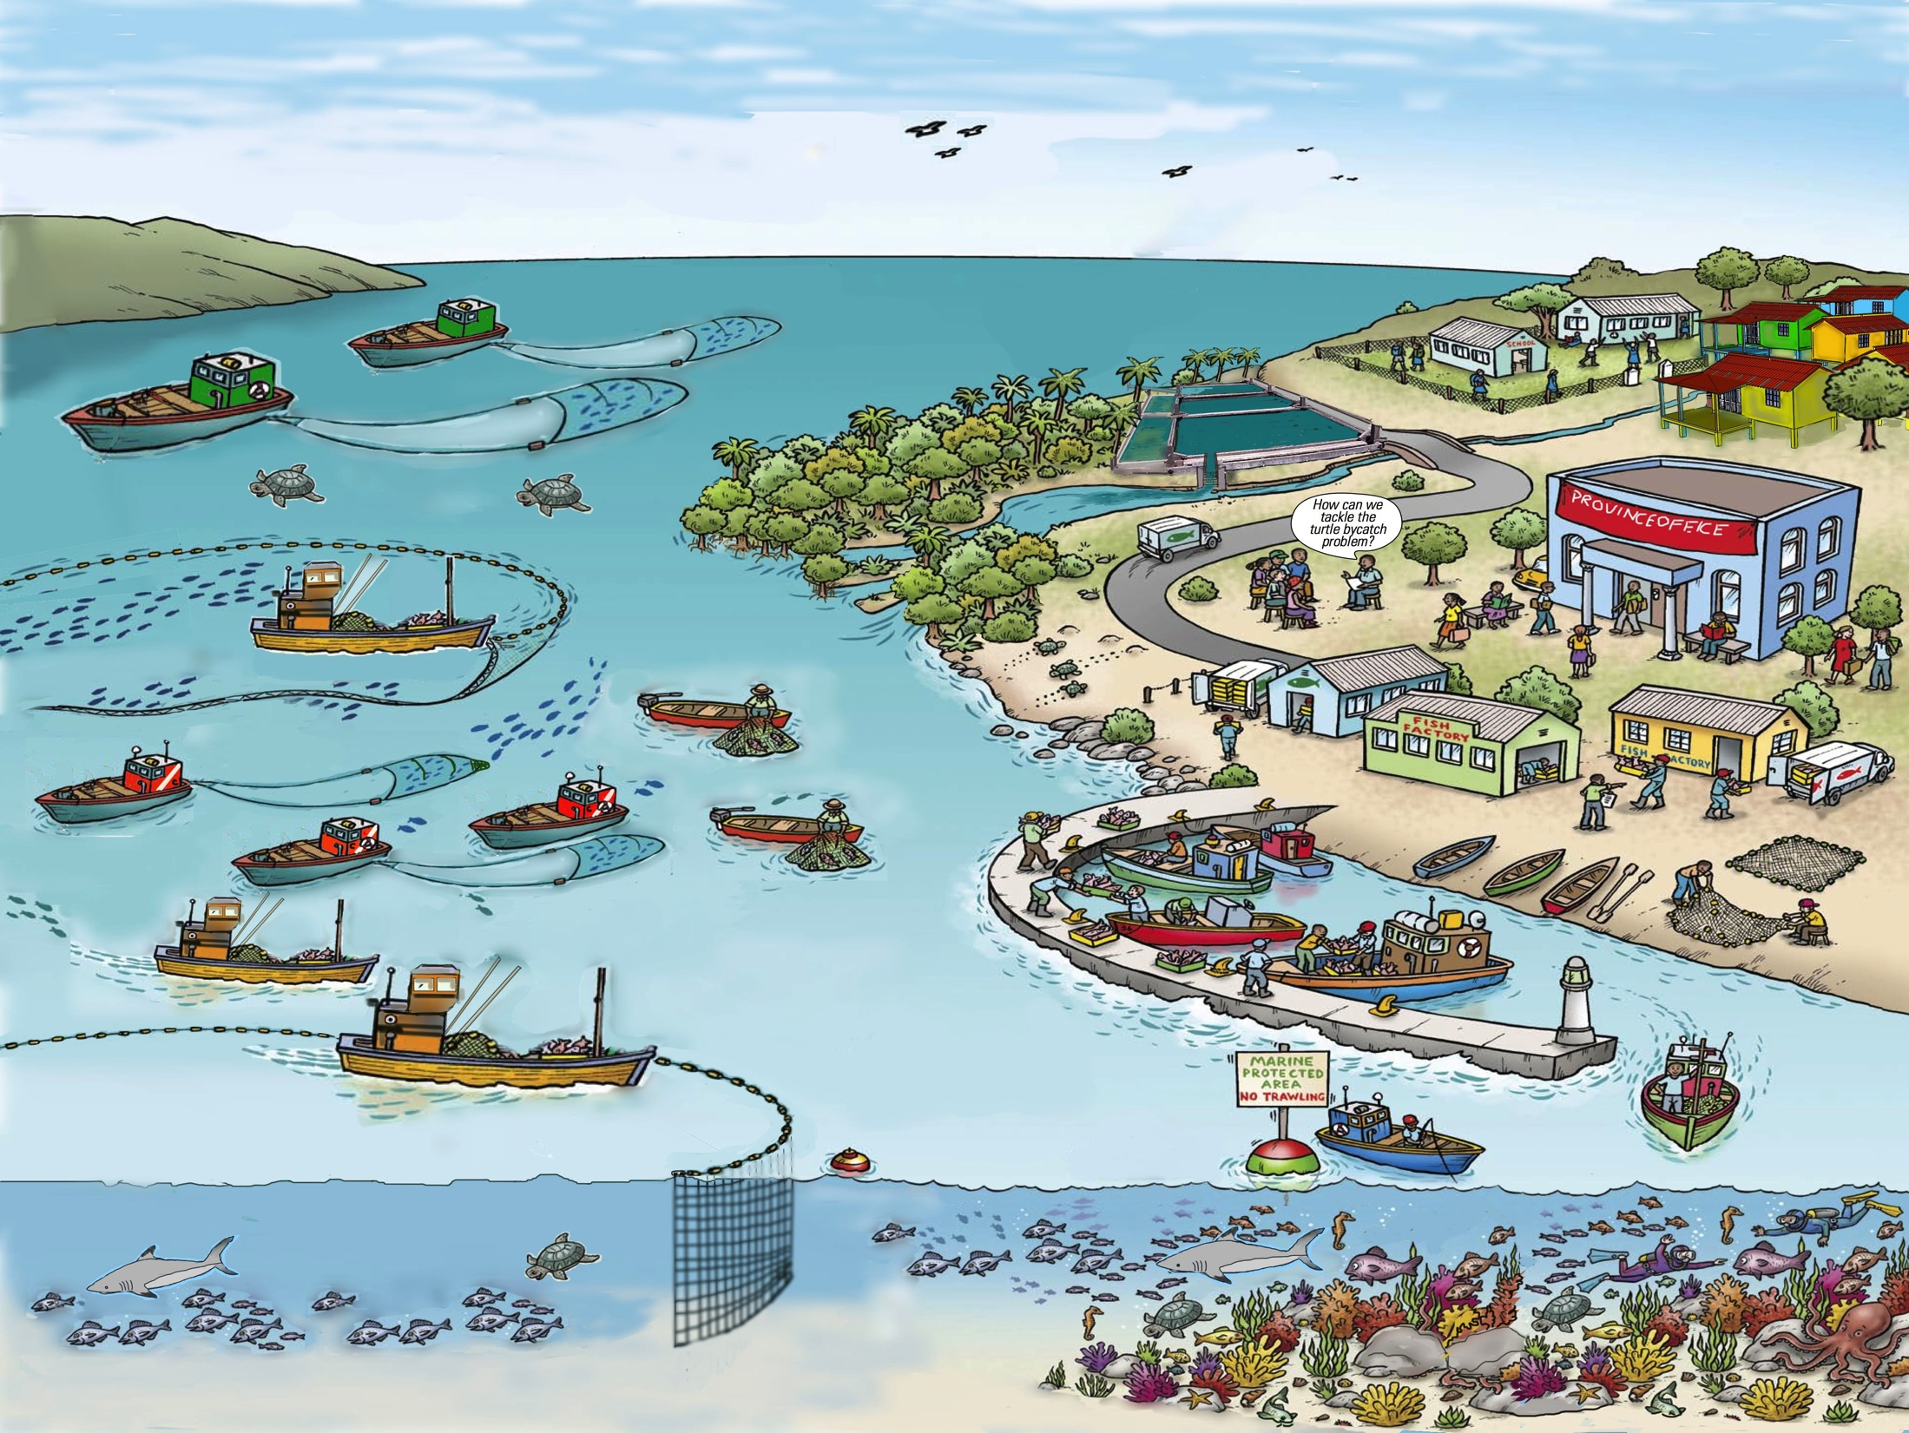
EAFM is the ecosystem approach (EA) applied
to fisheries management (FM)
Image adapted from FAO EAF Nansen Project
EAFM Bigger Picture
Notes:
EA + FM = EAFM
The ecosystem approach requires considering a bigger picture than just fish and fishing. In this diagram of an ecosystem also includes habitats (mangroves and coral reefs), other uses of the resources (aquaculture, scuba diving), endangered and threatened species (turtles) and post-harvest (fish landing site, processing and markets). Note that it also includes both small-scale and well as large-scale fishing as all these ecosystem components interact. NOTE: In this context, the ecosystem approach refers more to the structure and interactions within ecosystems, rather than the functional aspects such as energy flows as understood by scientists.
Also many other uses to be mentioned, and the impacts of fisheries, and also the other uses, on the habitats and resources (both fisheries and others)

Slide 4
Key principles of EAFM
1. Good governance
2. Appropriate scale
3. Increased participation
4. Multiple objectives
5. Cooperation & coordination
6. Adaptive management
7. Precautionary approach
Notes:
Seven principles that distinguish EA from existing/conventional fisheries management;
Good governance: especially improving transparency and accountability;
Appropriate scale: takes account of scale and delivers at the appropriate scale for the issue: political, geographic, multi-sectoral;
Increased participation: Stakeholders need to work together in management planning and implementation (co-management);
Multiple objectives: Takes account of the different objectives of different stakeholders and considers trade-offs;
Cooperation and coordination: Needed horizontally across sectors and agencies and vertically across levels of government;
Adaptive management: Learn through controlled trial and error; and
Precautionary approach: Don’t delay action because of a lack of information and be risk averse when there is uncertainty

Slide 5
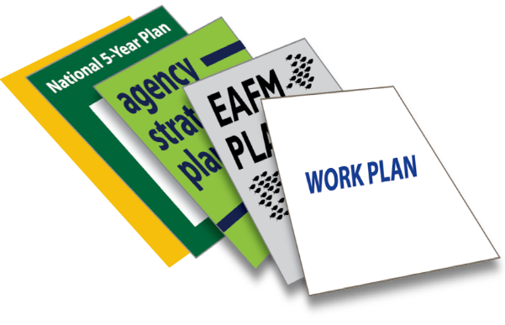
EAFM PLAN:
linking legislation & policy to action
Example
Sustainably manage fisheries
Legislation/policy
EAFM PLAN
Limit fishing effort in the trawl fishery
Control number of fishing boats/gears
Management actions
Notes:
EAFM encourages good planning, and implementing actions linked logically to these plans and higher level policies/legislation. It emphasises that having an EAFM plan will help link the high-level policy objectives, often derived from International Conventions, Treaties, and similar instruments, as well as national legislation and policies that already exist in most countries with actual management actions on the ground that will implement those policies.
Legislation and policies say what needs to be achieved. Plans (linked to rules and regulations) say how they will be achieved.
One example is given – one fisheries
Fisheries legislation (e.g. Fisheries Act ) and policies (e.g. 5-year National social and economic development plan) will often have an aim of “Sustainably management fisheries”. However, unless supported by practical plans that sets out management actions these aim will never be achieved. The plan specifies the need to limit the fishing effort in the trawl fishery and the management action of controlling the number of boats and fishing gear
Another ecological example:
Environmental legislation (e.g. Environment Protection Act) and policies (e.g. Marine conservation policy) often state have an aim of a “Healthy Environment”. To achieve this aim in a fisheries context, a plan is required that specifies the need to protect the fish habitat and a management action of closing a selected area through a marine protected area (MPA)

Slide 6
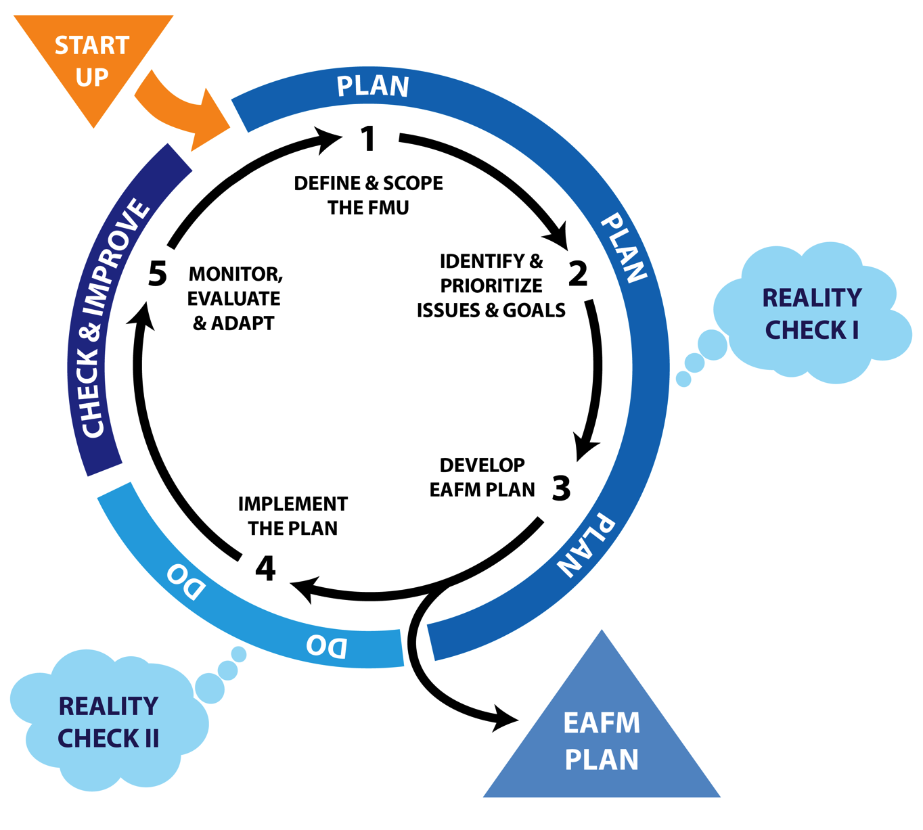
EAFM is based on
PLAN DO CHECK & IMPROVE
Notes:
The EAFM cycle is based on the generic management cycle of PLAN – DO – CHECK & IMPROVE
In EAFM there are 3 are PLANING steps, 1 DOING step and 2 CHECKING & IMPROVING steps – a total of 5 steps.

Slide 7
EAFM complements other approaches
Co-management
Conventional fisheries management
EAFM
Integrated coastal zone management
Marine spatial planning
EA/EBM
7
Notes:
EAFM complements other approaches that you may know:
The all-encompassing circle is EA/EBM. Within this we have:
co-management
integrated coastal zone management (ICM or ICZM),
Marine spatial planning (MPS), and existing fisheries management.
All of these approaches recognize that management must deal with broad ecosystem management (both natural and human components) and try to optimize the social and economic benefits.
Other approaches, such as Large Marine Ecosystems (LMEs) are similar, but at a different scale.
Diagram shows relationships – actual degree of overlap will vary from country to country – but not too extremely, e.g. so that EAFM falls fully within ICM.
Let participants explain why they think that circles should be moved to reflect the situation in their particular country.

Slide 8
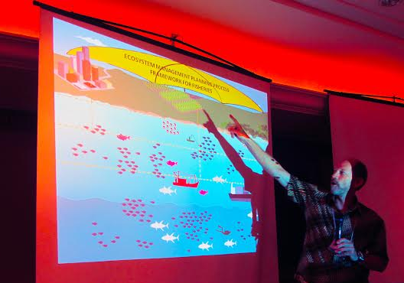
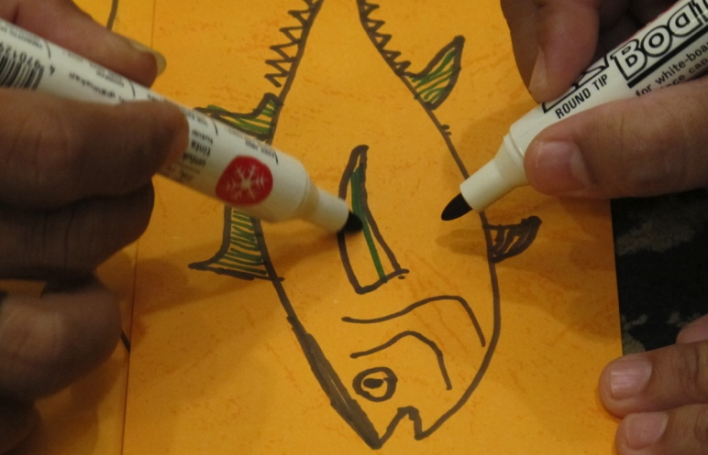
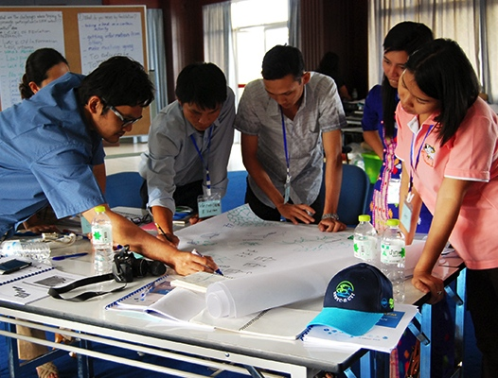
Essential EAFM training package
EAFM LEAD (leaders, executives, and decision makers) “tool box”
Regional trainers and training institutions
www.eafmlearn.org
Notes:
The E-EAFM course is a week-long comprehensive, hands on course to help staff involved in fisheries and environmental management implement EAFM and manage fisheries more sustainably.
The LEAD “tool box” has useful tools ranging from a 1 minute script and short videos through to a 1-day Executive Consultation that will help raise awareness and gain support of other leaders
Throughout various regions of the World, especially in Southeast and South Asia there are a large number of trainers qualified to assist in E-EAFM and LEAD and a number of training institutions have been established.
Find out more from EAFMLEARN.ORG

